Slide 1


Title Slide

Slide 2


Slide 3



Slide 4
Sending Culture Paradigm
Awareness
Concern
Engagement
Passion
Priority
Communal Tipping point --> Culture

Slide 5
How do we bring greater awareness of the realities of global missions to our people? How do we create a culture of “sentness” in our churches?

Slide 6


Slide 7
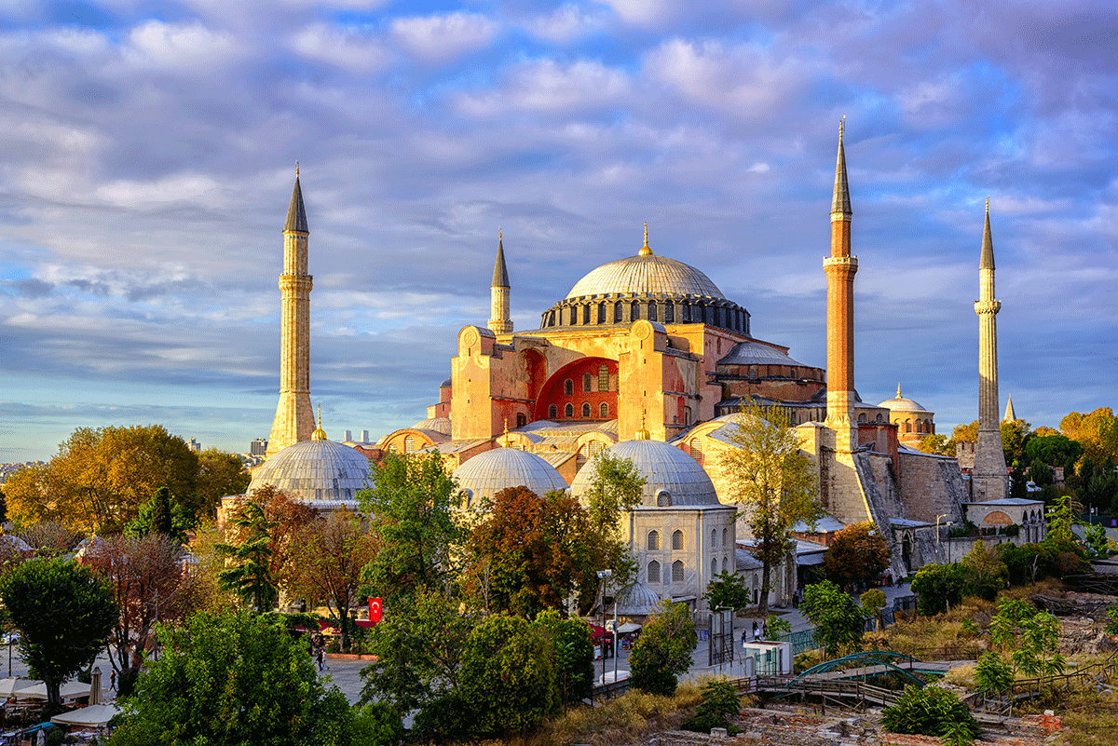
[picture of a building? Blueprints?]

Slide 8
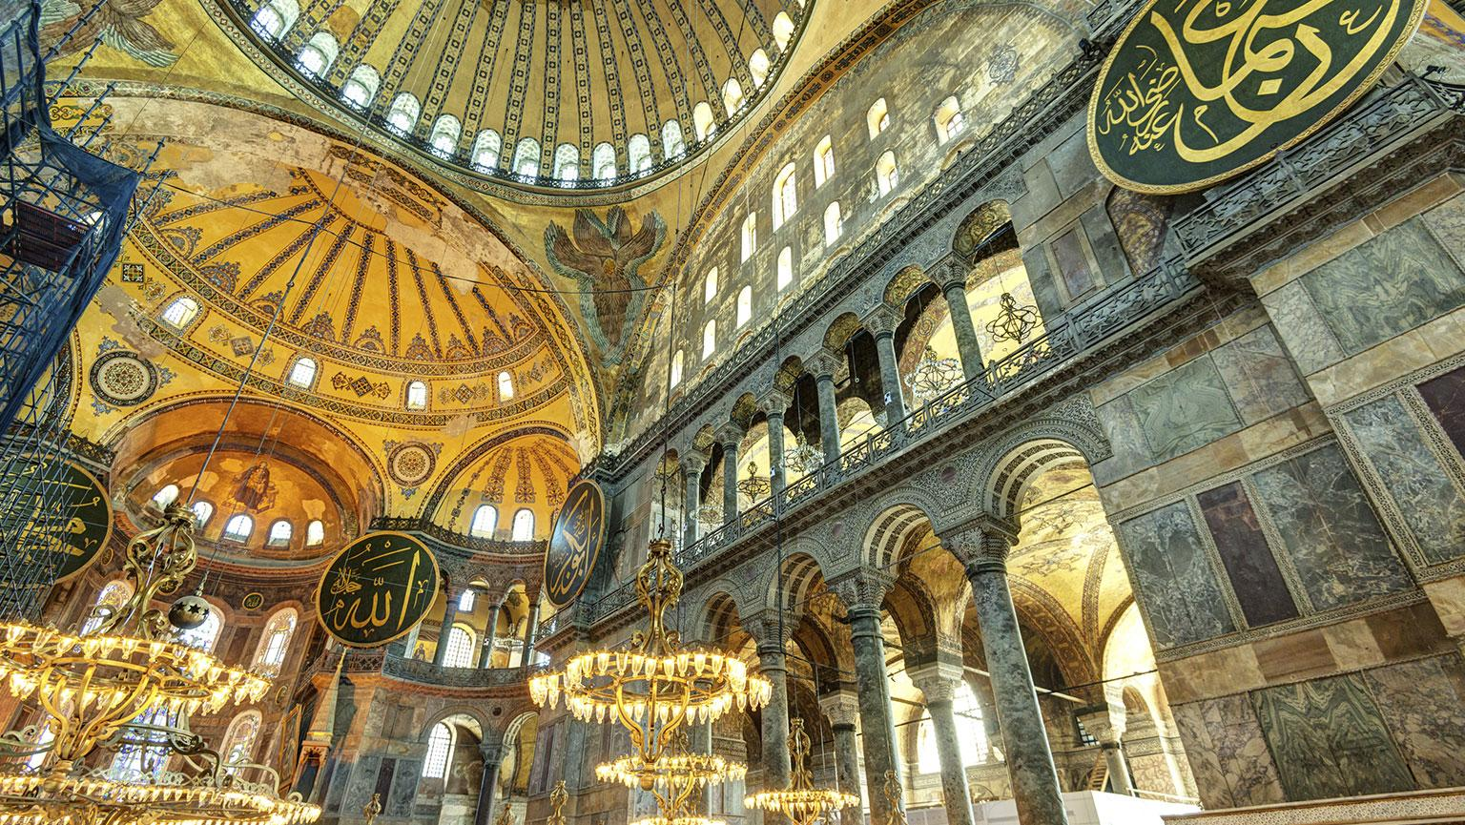

Slide 9
What should be driving our missions engagement?

Slide 10
Missions Convictions
A written document that provides foundation and clarity to the missions engagement of a local church.
Allows you to know what you believe and what is most valuable to you as a local church.
Acts as a written guide to help you know where to invest your limited resources, energy, and people.
All of your engagement, activity, and decisions should flow from your written convictions.
Allows you to say YES to what is most valuable and NO to everything else.

Slide 11
Questions to ask when developing convictions:
What does the Bible say about missions and the local church’s role in it?
What is the history/DNA/strengths of your church? What uniquely does your church have to offer the Kingdom?
What are the “passions” of your church? Of your lead pastor?
What are your own personal convictions (as a mission leader) when it comes to missions?
What convictions are you “adopting” and what convictions can you create? How can you honor the past but built toward the healthy future?

Slide 12
Establishing Missions Convictions
Homework: Slow down. Take a day away from your normal work responsibilities to create a rough draft of missions convictions for your church.
Spend time in the Word and in other mission resources.
Brainstorm with other missions leaders.
Get input and buy-in from your senior leadership and from sent ones.
Finalize and use this as a guiding document.

Slide 13



Slide 14
Assessment
Who knows potential missionaries best?
Their local church.
Who should you send? How do you know they’re ready to go?
You need a picture of what could be and should be.

Slide 15
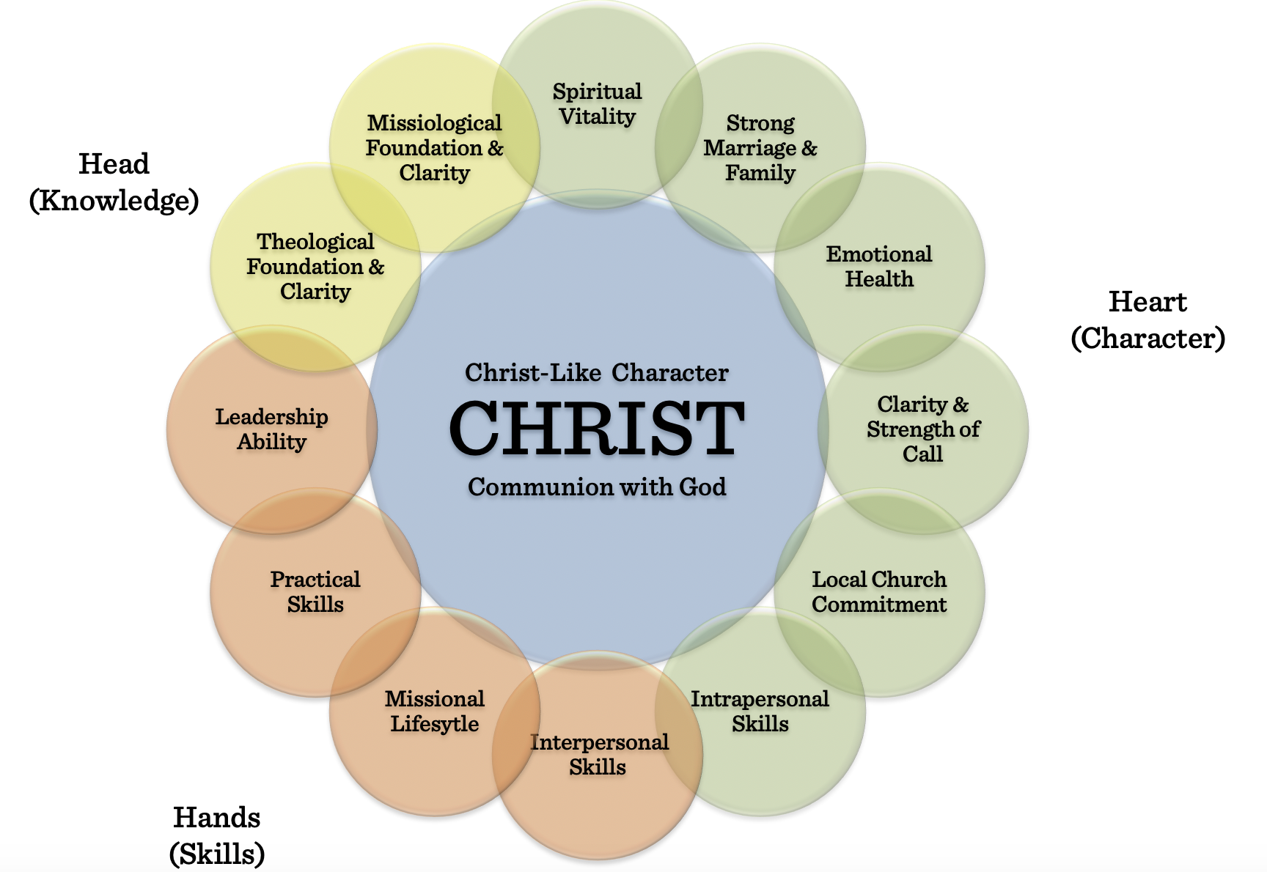
Traits of an Effective Missionary

Slide 16
Development
Myth: local churches are not equipped to prepare people for the field. – FALSE!
A sending church should take a significant role in developing people for the field.
There is no better place to develop the character and skills of a person than in the local church.

Slide 17
Development
Think holistic development:
Head: Knowledge
Heart: Character
Hands: Skills
Don’t just think cross-cultural skills but think discipleship and ministry skills.
The church is well poised to develop whole people to share the whole gospel to a whole world.

Slide 18

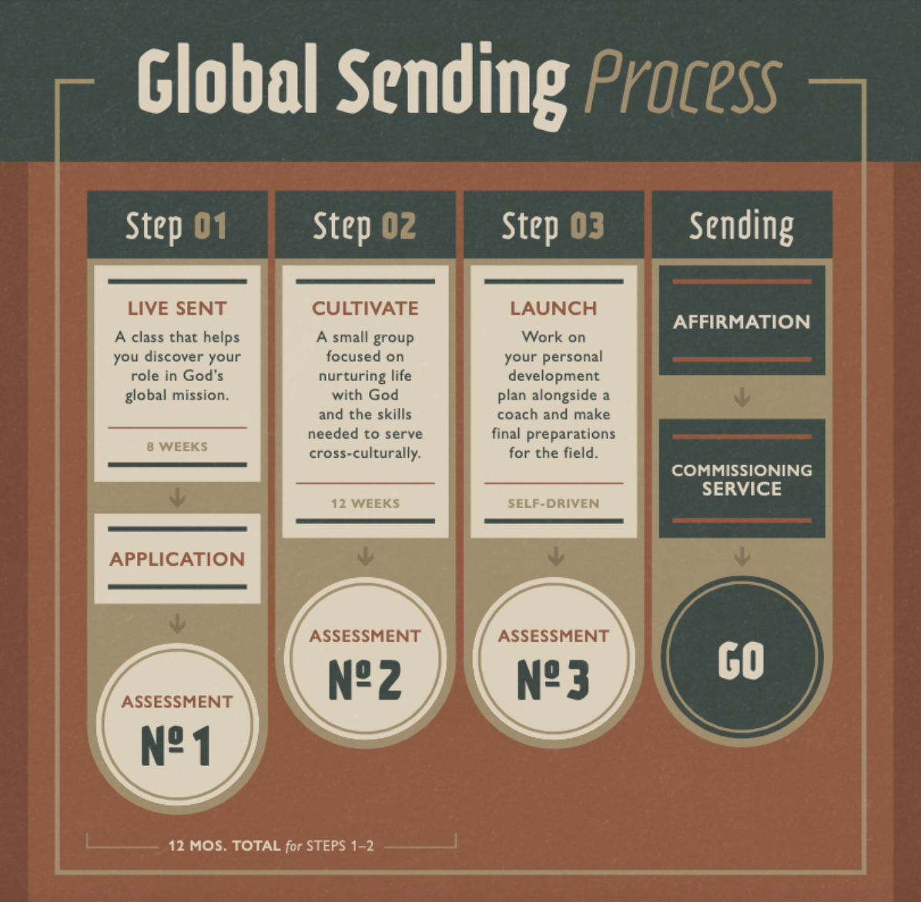

Slide 19


Slide 20


Slide 21
“The purpose of missionary care is to help missionaries remain whole throughout each stage of the missionary career life cycle. It involves supportive relationships and services which promote the missionary’s ongoing adjustment and growth.”
John Powell, Missionary Care

Slide 22
Member care from the local church:
Proactive care: his includes all the front end and ongoing care provided by the local church.
Reactive or crisis care: this includes responding to specific care needs that arise on the field. These may be requested by the missionary and arise out of crises.

Slide 23
Member care from the local church:
Examples of proactive care :
Pre-field education/development
Maintain ongoing relationships
Advocate/Barnabas teams
Regular video calls/text/emails
Care packages/mail
Sending short-term or care teams
Organized accountability from the local church
Ongoing education/development

Slide 24
Member care from the local church:
Examples of reactive/crisis care:
Scheduled care meetings through video calls, field visits, or when missionaries are stateside.
Traumatic or crisis situations on the field where a church will need to respond with intensive care.
The need to bring someone home for any number of reasons.

Slide 25
Member care from the local church:
If we are going to send people out from our churches; we also need to be ready to stay with them once they go. This includes:
Caring for them proactively
Partnering with them in the work
Working through difficult issues that may arise
Receiving them back in a way that honors God and loves them well.

Slide 26
2 final thoughts on member care
Build systems and structure within the church that assures that good care happens.
Your intentional pursuit of people and presence with people is the best proactive care you can give.

Slide 27
Title Slide

Slide 28







