Slide 1
Welcome!

Slide 2
Emotional Intelligence for the Christian Leader
Presenter: Jackie Lebron

Slide 3
Agenda
About me
What are emotions?
What is emotional intelligence?
Why is emotional intelligence important?
How can we improve our emotional intelligence?

Slide 4

About Me
NY → NJ → FL
22 years in HR
Christian 6 years
Wycliffe 5 years
Director in HR
Expert in emotions
Notes:
*Disclaimer: I am not a therapist or a psychologist. I am just a human that has experienced a lot of emotions so I decided to learn about them.

Slide 5
Emotions Defined
The brains complex reaction to an experience that results in a physiological, cognitive and/or behavioral reaction.
Notes:
There are many ways to define emotions. For the purposes of this session, I summarized several definitions I found.

Slide 6
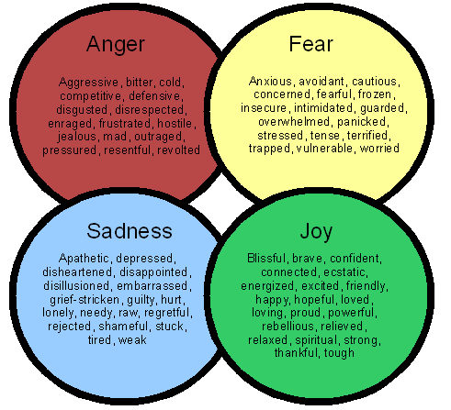
Emotions vs Feelings
Feelings are the conscious reaction to emotions.
Notes:
You might ask then, how are emotions different from feelings? [read slide] Emotions give rise to feelings. As you can see in this graphic, there are many feelings that result from one particular emotion.

Slide 7
The Bible on Emotions
Anger
Be angry, and do not sin; ponder in your own hearts on your beds, and be silent. Selah -Psalm 4:4
Fear
For God gave us a spirit not of fear but of power and love and self-control. -2 Timothy 1:7
Sadness
He will wipe away every tear from their eyes, and death shall be no more, neither shall there be mourning, nor crying, nor pain anymore, for the former things have passed away. -Revelation 21:4
Joy
You make known to me the path of life; in your presence there is fullness of joy; at your right hand are pleasures forevermore. -Psalm 16:11
Notes:
From Genesis to Revelation, the Bible includes stories of many people called by the Lord to serve His will and purpose. Many are recorded as experiencing a wide range of emotions. In Genesis 4:5-6 Cain got angry with God because he was dismissive of his offering. God himself was angry throughout the Old Testament!
Can anyone name one person in the Bible that exhibited fear? Sadness? Joy?

Slide 8
Emotional Intelligence Defined
The ability to:
Recognize, understand and manage our own emotions and;
Recognize, understand and influence the emotions of others.
Notes:
According to the Institute for Health and Human Potential….(read slide)
In practical terms, this means being aware that emotions can drive our behavior and impact people (positively and negatively), and learning how to manage those emotions – both our own and others.

Slide 9
Brief History of Emotional Intelligence
Term created in 1990 by two researchers, Peter Salavoy and John Mayer.
Popularized by Dan Goleman in his 1995 book Emotional Intelligence.
Goleman’s research centered in context of work.
Notes:
The term emotional intelligence was created by two researchers, Peter Salavoy and John Mayer in their article “Emotional Intelligence” in the journal Imagination, Cognition, and Personality in 1990. It was later popularized by Dan Goleman in his 1995 book Emotional Intelligence. His research centered around EI in the context of work.

Slide 10
Importance of Emotional Intelligence
Have uncomfortable conversations
Manage our emotions in high stress situations
Improve relationships
Resolve conflicts
Coach and motivate others
Create a culture of collaboration
Build psychological safety within teams
Notes:
Emotional intelligence helps us to [read slide]

Slide 11
Emotional Intelligence Skills
Self-awareness
Self-regulation
Social Awareness
Relationship Management
Notes:
The skills required to build emotional intelligence are: [read slide]

Slide 12
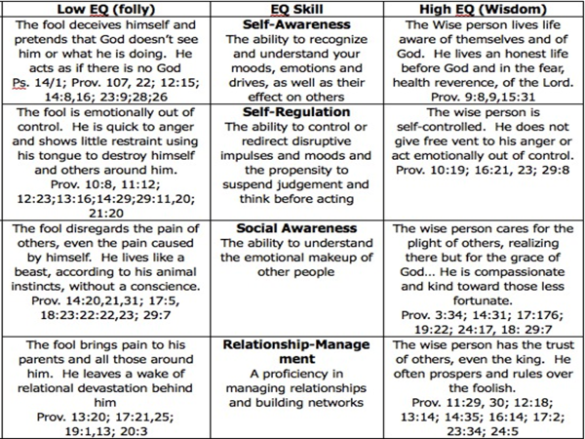
The Bible on Emotional Intelligence
Notes:
As I was doing my research I found the book of Proverbs was really an instruction manual on emotional intelligence.

Slide 13
Improving Your Emotional Intelligence
Learn how to identify your emotional state.
Seek to understand. Listen and observe non-verbal cues, ask questions.
Focus on relationships.
Notes:
Emotionally intelligent adults respect others and their opinions, and do not feel the need to change them. They can appreciate people for who they are and can take responsibility for their own actions, thoughts and feelings. So how do we improve our emotional intelligence?
Learn how to identify your emotional state.
Expand your emotional vocabulary. Instead of just having a bad day, maybe it is really a draining or distracted day. Perhaps we are actually just frustrated and not angry or mad.
Acknowledge your emotions. This will require a self-awareness so that you can stop and reflect.
Differentiate and analyze your emotions. Are you angry or sad? What feeling is being provoked by this emotion.
Accept and appreciate emotions. Emotions make us empathetic.
Reflect on your emotions and their origin. What is the root cause of the emotion you are experiencing?
Handle your emotions. Do no suppress them! Work THROUGH them.
Seek to understand. Listen and observe non-verbal cues, ask questions.
Handle the emotions of others by understanding that they may not be as aware of their emotions.
Listen reflectively by repeating back what they have shared.
Ask open ended questions. Be careful not to “assign” an emotion to them.
Focus on relationships.
Work flows through relationships.
Relationships are valuable.
Our triune God is the perfect reflection of relationship.

Slide 14
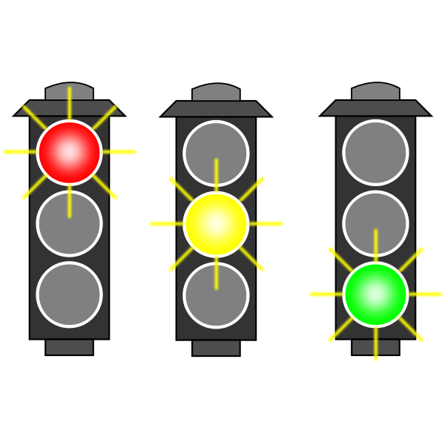
The Stoplight Approach
The three brain states:
Red Brain - fight, flight, freeze or appease
Yellow Brain - feeling disconnected
Green Brain - using all of your brain to experience life
Notes:
In working with her own adopted children, Cherilyn Orr developed what’s now known as The Stoplight Approach. Based on research into child development and behaviour management, Orr helps parents equip their children to understand their emotions by using the universal language of the traffic light.
Interestingly, in their work with adults and couples in distress, Focus on the Family Canada’s counselling team has found that The Stoplight Approach is a valuable tool for those of us who have never been shown how to regulate our emotions.
In this reactive state, you are unable to listen, to concentrate or to think clearly, which means you are not able to come to any resolution. The red brain is you in survival mode with only self-protection as your main concern.
The yellow brain is a step away from red brain where you may not feel like you’re in survival mode, but you do feel disconnected. You may be tired and stressed, you may be hungry. Your worry, listlessness or annoyance makes you vulnerable to quickly slipping into red brain.
Green brain is the state in which you are using all of your brain to fully experience life, focus on your tasks, cooperate with those around you and find healthy solutions to the problems you face. When we are in green brain, we feel safe, secure and content. Green brain enables us to thoughtfully see the world around us – and the emotions within us – with perspective.
Simply put, emotional intelligence is our ability to go from red brain and yellow brain back to green brain. It’s not that emotionally intelligent people are never in red brain or yellow brain; it’s that they have high emotional resilience that allows them to bounce back to green brain.
As with any skill, this is one that takes practice. Before anything else, you need to learn to identify what you’re feeling.

Slide 15

5 Steps of the Care Cycle
Aware
Accept
Allow
Attend
Act
Aware
Act
Accept
Attend
Allow
Notes:
In the Marriage Enrichment program at Focus on the Family in CAnada, their marriage therapists help couples develop their emotional intelligence by teaching them the five steps of what’s called the Care Cycle:
First, learn to be aware of when you are feeling something. You may not know what the feeling is, but you can sense your body responding to a difficult emotion. When this happens, give yourself space to find comfort, clarity and objectivity – what Reed and Hooper refer to as “taking space to care for my heart.” This may require you to physically remove yourself from what’s triggering you.
“The thought of looking beneath the surface at our hearts can be frightening, especially if we are used to ignoring our feelings. But God has given us feelings as information – like our own early warning system; they signal to us that something important is going on with us and we need to attend to it. If we ignore them, we will find other things in our life are affected.”
Allow God into the process. God is for you and desires to be invited into what you’re feeling. This step of allowing God into our process is incredibly valuable. It may even be helpful for you to have the following verse saved on your phone or posted in your home to help you remember this crucial step: “Search me, O God, and know my heart! Try me and know my thoughts! And see if there be any grievous way in me, and lead me in the way everlasting!” (Psalm 139:23-24)
Now that you’ve identified what you’re feeling, you’re aware of it, you’ve accepted it and you’ve allowed God into it, you can start to regulate your emotions. Ask yourself if this feeling is familiar, if you’re amplifying it or distorting it. Pray and ask God to reveal to you what the truth of the situation is, not what you perceive the truth to be. “When what we say, what we hear, and what we mean are not in agreement,” she writes, “we retreat into our heads and make up stories that help us reconcile the discrepancies.” -Glasser Part of attending is being able to set those perceived truths aside in order to take ownership for our part in what we’re feeling and take steps to be more resilient in moving toward green brain.
This process of personal reflection and self-regulation is what enables us to connect with others. If you are not emotionally intelligent and you are constantly stuck in a state of red or yellow brain, you are incapable of meaningful connection with people. When you are able to go through this Care Cycle process and choose to respond instead of react, you can show empathy and improve your relationships.
Taking ownership of your emotional well-being and continually finding ways to develop your emotional intelligence enables you to be a whole person.

Slide 16
Call to Action
Pray - ask the Holy Spirit to reveal to you what the Lord is calling you to do based on what you learned today.
Plan - a goal without a plan is just a dream. Write down what the Holy Spirit has revealed to you and how you will respond.
Do - what action steps will you take in the next six months? How will you hold yourself accountable?

Slide 17
Citations & Resources
“The Meaning of Emotional Intelligence”, web article, Institute of Health and Human Potential, https://tinyurl.com/mv5yb5am
Emotional Intelligence, book, by Daniel Goleman
How to Improve Your Emotional Intelligence for Career Success, YouTube, Shade Sahrai
6 Steps to Improve Your Emotional Intelligence, YouTube, TedxTum, Ramona Hacker
Christian Perspective on Emotional Intelligence, web article, LinkedIn, Robert Jerus, SPHR, https://tinyurl.com/s4fd5fy3
How to Become Emotionally Intelligent, web article, Focus on the Family Canada, Sam Doerksen, https://tinyurl.com/5h9xbcm7
5 Steps to Developing Your Emotional Intelligence, web article, Focus on the Family Canada, Amy Van Veen, https://tinyurl.com/4m5jw5v3

Slide 18
Thank You!
Jackie Lebron
Director of Staff Management & Benefits
Wycliffe Bible Translators, USA
jackie_lebron@wycliffe.org

