Slide 1
Designing STMs to Engage & Equip Gen Z

Slide 2
Generations Today
Silent: Born 1928-1945
Boomer: Born 1946-1964
Gen X: Born 1965-1980
Millennials/Gen Y: Born 1980-1995
Gen Z/Homelanders: Born 1995-2010
Generation Alpha: Born after 2010

Slide 3

Based on your experiences and relationships with students, what do you see as Gen Z’s most important traits, habits, attitudes, or perspectives?

Slide 4
Challenges for Gen Z engaging in missions
Post-Christian culture; Biblical illiteracy, decline in church attendance
Post-missions culture; lack of missions awareness and understanding
Gen Z values: tolerance, individualism, financial security and personal happiness
Helicopter/Lawnmower parenting; lack of resiliency, confidence
Culture of fear, anxiety about important decisions, fear of failure, and uncertainty about the future (emotion-driven responses)
Identity and sexual brokenness
Mental health concerns and technology addiction

Slide 5

Today’s society is especially and insidiously faith repellent…
Resilient faith is tougher to grow today using the cultivation methods we relied on throughout the twentieth century.
There is a countercultural 10% of young Christians whose faith is vibrant and robust.
Just under four million 18-29-year-olds in the US who follow Jesus and are resiliently faithful.
Kinnaman, D., & Matlock, M. (2019). Faith for exiles : 5 ways for a new generation to follow Jesus in digital Babylon. Baker Books.
‌
‌

Slide 6
Intergenerational relationships are crucial. The number one predictive factor as to whether or not a young Christian will retain his or her faith is whether that person has a meaningful relationship with an older Christian.
--Drew Dyck, Next Gen Author

Slide 7

An adult now makes eye contact between only 30 and 60% of the time in a typical conversation, but emotional connection is built when eye contact is made during 60-70% of the conversation…they less eye contact, the less a connection is made.

Slide 8
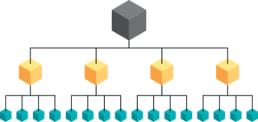
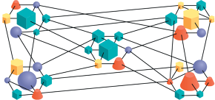
Notes:
From Team of Teams

Slide 9
Takeaway #1 (Standards 2, 5): Focus on strong relationships with leaders, team members and missionaries/partners. What are ways you have done/could do this pre-field, on-field, post-field?

Slide 10

Gen Z/Gen Alpha are EPIC learners:
Experiential
Participatory
Image Rich
Connected

Slide 11
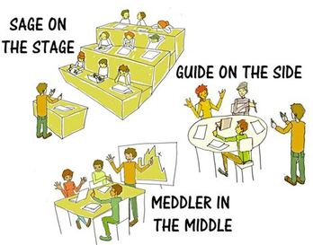
How teaching and learning are changing:
Power distance is collapsing, authority is gained through relationship
Motivation to learn based on what “feels” relevant, versus what we are told is important
Schools have traditionally “downloaded” information students are now “uploaders”
Socratic Method
EPIC Teaching
Coach Approach

Slide 12
Goal: Productive discomfort, with support, that encourages critical thinking, creativity, problem solving, deep understanding and confidence
Socratic Method
EPIC Teaching
Coach Approach

Slide 13
The Importance of “Why”
Next generation needs to know why; they are used to asking “why” and finding answers
If we don’t answer their questions, they will find answers somewhere.
Understanding “why” helps equip them for leadership in the future; provides the flexibility of knowing the vision vs. just the process
They can access information, need help with interpretation; creating space for their questions and comments allows them to engage and retain information

Slide 14
Takeaway #2 (Standards 6 & 7): Actively engage their participation and ownership in learning (missions awareness/terminology, biblical literacy, ministry context, etc.) and provide space for them process what they are experiencing and learning. What are ways you have done/could do this pre-field, on-field, post-field?

Slide 15
Individualism/Identity
Individualism is behind the most fundamental changes of the last few decades
Gen Z most individualistic generation; able to customize and personalize their lives
Individualism encourages people to feel good about themselves; negative emotions indicate something is wrong
Individualistic times tend to be less religious times. Identity and personal “truth” determined by self, not group
Twenge, J. M. (2018). IGen : why today’s super-connected kids are growing up less rebellious, more tolerant, less happy--and completely unprepared for adulthood (and what this means for the rest of us). Atria Paperback.
‌
.
‌

Slide 16
Individualism/Identity
Emotional safety and well being have become priorities (our emotions are very individual)
Relativism and pluralism recognize and affirm every person’s views and values as being valid
Gen Z is hesitant to say something is “wrong,” it is up to the individual
Twenge, J. M. (2018). IGen : why today’s super-connected kids are growing up less rebellious, more tolerant, less happy--and completely unprepared for adulthood (and what this means for the rest of us). Atria Paperback.
‌
.
‌

Slide 17

Tolerance in a individualistic/pluralistic culture:
Understanding
Respect
Acceptance
Affirmation
Celebration

Slide 18
“Tolerance is the new buzzword and the new law of the land, and it has a different definition than it did just a few years ago. Tolerance used to mean that we recognized and respected other people’s beliefs and value systems without agreeing with them or sharing them. Today tolerance means that everyone’s values, belief systems, and lifestyles should be accepted.”
Hawkins, O. S. (2016). The Daniel code : living out truth in a culture that is losing its way. Thomas Nelson.
‌

Slide 19

Emotions and Facts
post-truth adjective
Relating to or denoting circumstances in which objective facts are less influential in shaping public opinion than appeals to emotion and personal belief.
--Oxford Dictionary 2016 Word of the Year
“Facts are your friends.”
--Dr. John Delony

Slide 20

The “Coach Approach”
“Coaching is an ongoing intentional conversation that empowers a person or group to fully live out God’s calling.”
--Keith Webb, The COACH Model
Questions are the key to the “coach approach”
Webb, K. E. (2019). The COACH Model for Christian leaders : powerful leadership skills for solving problems, reaching goals, and developing others. Morgan & James Publishing.
‌

Slide 21

Sample Questions: Processing Emotions
What negative emotions are you experiencing and where do you think those are coming from?
What could God be speaking to you in these fears/doubts/emotions?
Do you see anyone expressing that emotion in the bible and how do they/the Lord respond?
What things does this concern reveal you need to believe or trust about God?
In what order do you want this feeling to place amongst the other feelings and beliefs you have about this opportunity?
Erlacher, J., & White, K. (2022). Mobilizing Gen Z Challenges and Opportunities for the Global Age of Missions. William Carey Publishing.
‌

Slide 22
Active Listening
Ask good, open-ended questions.
Focus your attention on the speaker. Make eye contact.
Consider body language, facial expressions, tone, and emotions.
Do not interrupt the speaker or assume a conclusion before the speaker has finished.
Do not think about what you are going to say next. Listen to what they are saying and react without judgment. Summarize main points once the speaker is finished, using phrases such as, “what I heard you say is” or “let me summarize your points to make sure that I heard you correctly.”
Seek to sense what the Lord is doing/saying and encourage the individual in that.

Slide 23
Takeaway #3 (Standards 1, 6 & 7): Provide training and resources for leaders (coaching skills, mental health awareness, generational trends) and participants (journals, debriefing, mentor/coach) to help Gen Zers process their emotions, be focused on what God is doing, and understand the truth that God is revealing through this experience. What are ways you have done/could do this pre-field, on-field, post-field?

Slide 24
Generational Motivations for Missions
Millennials
Gen Z
-Motivated by making a difference in the world. -Want to make the world a better place. -Want to be a part of a bigger movement towards good -More collective, not individual -If you could paint a picture of the problem they would alleviate, they got excited
-They are motivated by personalization (sharing memes, that’s “so me”) -Like feeling understood, seen, heard, celebrated -Want to leverage their skills, lean into who they are, invest into something that matters -More individual, not collective -If you can paint a picture of how they can be used to help alleviate a problem, they get excited

Slide 25


“The speed and interdependence of events had produced new dynamics that threatened to overwhelm the time-honored processes and culture we’d built…I began to view effective leadership in the new environment as more akin to gardening than chess.”
—General Stanley McChrystal, USA (Ret.), and author of Team of Teams

Slide 26
Takeaway #4 (Standard 1 & 2): Provide space for Gen Z to reflect and discuss where God is working in them and the ministry with whom you are partnering; affirm individual gifts and contributions of where you see God working in and through them. What are ways you have done/could do this pre-field, on-field, post-field?

Slide 27
Today’s SCENE:
Our world is full of: Consequently,
Gen Z can assume:
S – Speed Slow is bad.
C – Convenience Hard is bad.
E – Entertainment Boring is bad.
N – Nurture Risk is bad.
E – Entitlement Labor is bad

Slide 28

Mental Health Trends
Gen Z is experiencing a mental health crisis
22% of 21-year-olds are anxious (always or usually anxious about important decisions, afraid to fail, and uncertain about the future)
Gen Z is the loneliest generation
Stats from iGen by Jean Twenge; CDC; Barna Research

Slide 29
Technology Trends
The correlation between social media use and loneliness appears across all demographic groups
Eighth graders who are heavy users of social media increase their risk of depression by 27%, while those who play sports, go to religious services, or even do homework cut their risk significantly.
Common Sense Media

Slide 30
Technology Trends
42 percent of young children (under 8) now have their very own tablet device — up from 7 percent four years ago and less than 1 percent in 2011.
Many teens/young adults check phone up to 80X a day or every 20 minutes, average 8-12 hours/day on screens
Common Sense Media

Slide 31

Signs of Technology Addiction
+Individual gets anxious or angry if they don't have their device +Tech usage negatively impacts schoolwork, relationships or other interests +Individual stays up later and later with device or computer +Individual seems more apathetic or bored more easily +Individual has more difficult time regulating emotions +Individual falls asleep in classes/meetings
Adapted from Glow Kids by Dr. Kardaras
‌
‌

Slide 32
Takeaway #5 (Standards 6 & 7): Create and communicate clear guidelines and expectations upfront to participants (and parents) regarding technology use; time commitment; attitudes; relationships; etc. Provide some “simulations” of experience ahead of time (tech-free zones/periods; good mental health practices; etc.) What are ways you have done/could do this pre-field, on-field, post-field?

Slide 33
Generation Z Traits to Nuture
Self Learners/Entrepreneurial
Curious/Well Informed
Independent and Individualistic
Cautious/Realistic
Diverse
Future-Focused
Work for Success
Resiliency/Courage (Remnant)

Slide 34
The Call of a Remnant to the Global Age of Missions
“The great commission is still for everyone. But now the mission is from everywhere to everywhere. The future we know is going to be different than the past, and as we look to the future, my hope is that we will listen to voices of the majority world who are already modeling what integral mission with a priority on evangelism can and does look like.”
--Ed Stetzer, Executive Director of the Wheaton College Billy Graham Center and Dean of the School of Mission, Ministry, and Leadership
The Post-Missions Age. Presented by Ed Stetzer. Missio Nexus, 2019. Conference Presentation. Accessed January 4, 2021. https://www.youtube.com/watch?v=B8JVE1yMxaQ.
‌
‌
‌

Slide 35
I believe that every person has been called to go…the call to go is from everywhere to everywhere…and God has not announced that He has stopped sending Americans, God has not announced that He has stopped sending Europeans. Thank God that it is the day for Africa to rise up. As Africa, Asia, and Latin America are rising to do missions, God did not say America stop, it is now time for Africa, it is now time for Asia. No, no. We have to work together, this is Kingdom work, and God has called all of us to work.
--Reuben Kachala, National Director for Frontier Missions International in Malawi
Notes:
https://en.oxforddictionaries.com/word-of-the-year/word-of-the-year-2016

Slide 36
Opportunities for future generations in missions
Emergence of the “Global Age” of missions, opportunities to partner in a variety of ways, often to learn
Innovative ministry methods, teams, and programs (mid-term; loan forgiveness; team models; coaching & mentoring in ministry)
Opportunities afforded by technology for ministry/work
Emerging “gig” and global economy, that allows for funding ministry, as well as flexible and mobile work/ministry options

Slide 37
Questions & Comments Evaluations

Slide 38
What is one takeaway for your context?

Slide 39


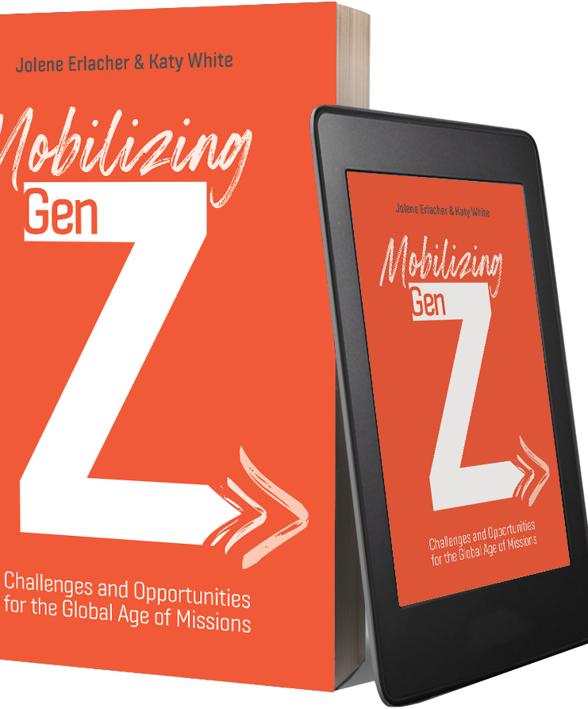
www.leadingtomorrow.org
More resources at

