Slide 1
Current Trends in the Islamic World
Dick Brogden – Missio Nexus 2022

Slide 2
1. Volume of Prayer and FASTING
Solidarity across Regions
Harmony of Prayer Houses/Initiatives/Movements
24/7 Ramadan and Event Focuses
“This kind cometh not out but by prayer [and fasting]”
Matthew 17:21, Mark 9:29

Slide 3
2. SECULARISM WITHIN ISLAM
We have a growing post-Islamic generation of youth – we need to rethink evangelism and discipleship
They are not arguing apologetics as much, they are asking “secularist” questions:
- “If God is good, why is there so much suffering in the world?”
-“Would God really send the majority of people to hell?”

Slide 4
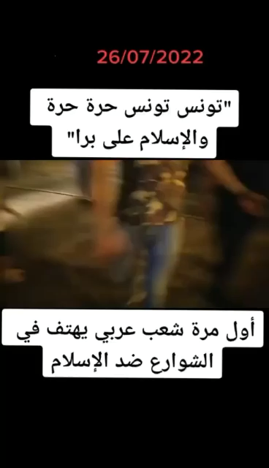
“Tunis is Free….
Away with Islam.”

Slide 5
3. MEDIA IS A GREAT SERVANT…
AND A TERRIBLE MASTER
We cannot allow media interaction (chat rooms, virtual reality and the metaverse) to become endgames.
Media must be means not ends. We are integrated creatures designed for physical presence, touch, and interaction – including with those we don’t like and can’t remove from the community with a click of the button.
- It is also an open question as to whether media attracts/preselects the fringe/troubled or if this extreme brokenness is true of all who exit Islam.

Slide 6
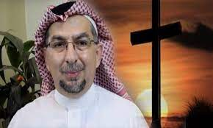
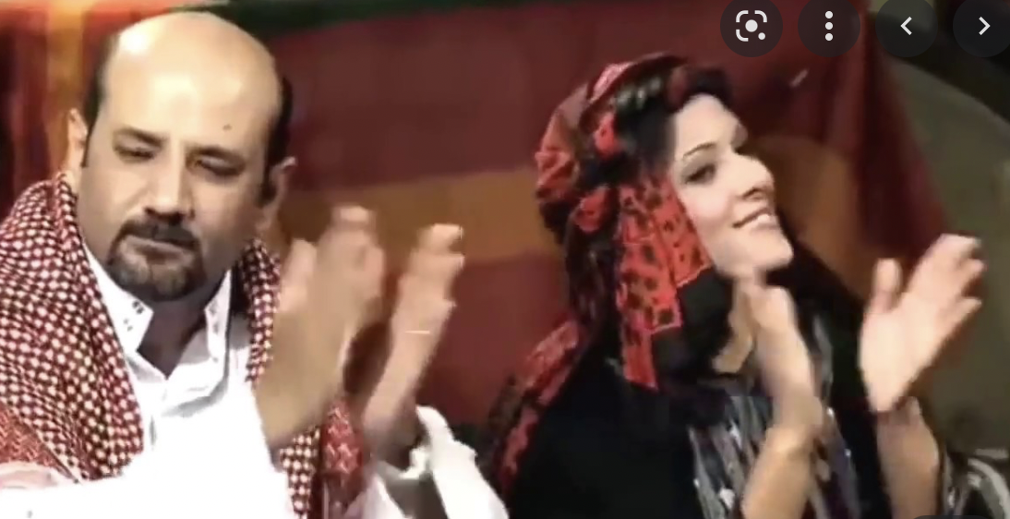
4. Public Presence, Visible Church, Physicality.
We are (surprisingly perhaps) entering a season where the local church must be seen. (AP Examples)
We need to find increasing ways for the church to be broadcast, seen, found, visited, and be public. It is time to press for this, and it has the effect of letting the masses know that the AP church exists and is composed of normal and good people.

Slide 7
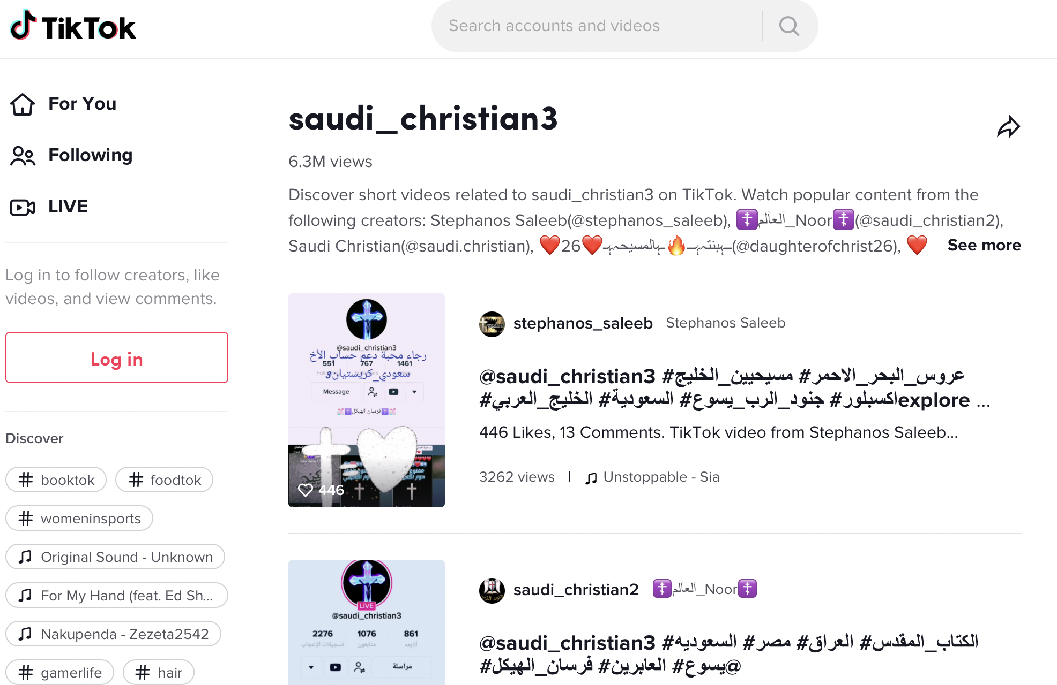
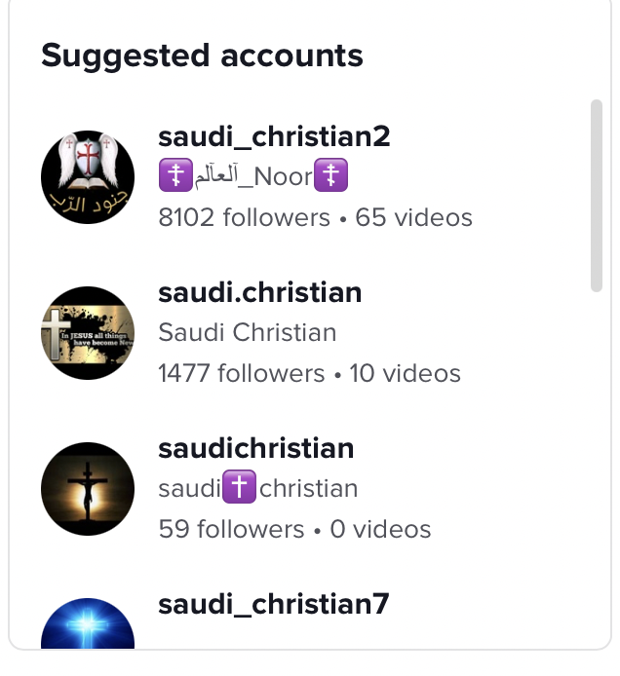

Slide 8
5. Workers Modeling Suffering
Global Workers must have the moral authority to ask their disciples to follow the Biblical injunctions to suffer and take up the cross and face danger and do difficult things that require risk. We cannot do this if we are not willing to risk ourselves (our residency, our jobs, our security, our possessions, our families).
We have to live dangerously if we are going to call others to live dangerously.

Slide 9
6. Preaching and Teaching
As a corrective to the pendulum swing to discovery as the only method (it is valid but not absolute) we must focus on doctrine, theological training, bold preaching and teaching going forward. The training and teaching must be contextual and wherever possible non-residential, but all the same robust and didactic in part. (It is a both/and of discovery and didactic)

Slide 10
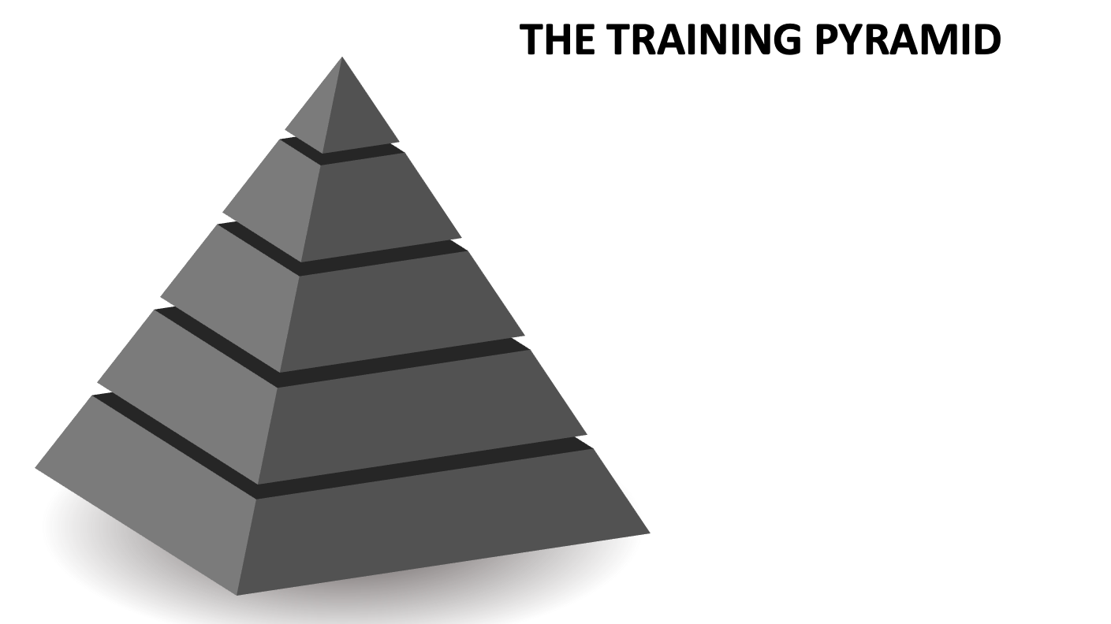

Slide 11
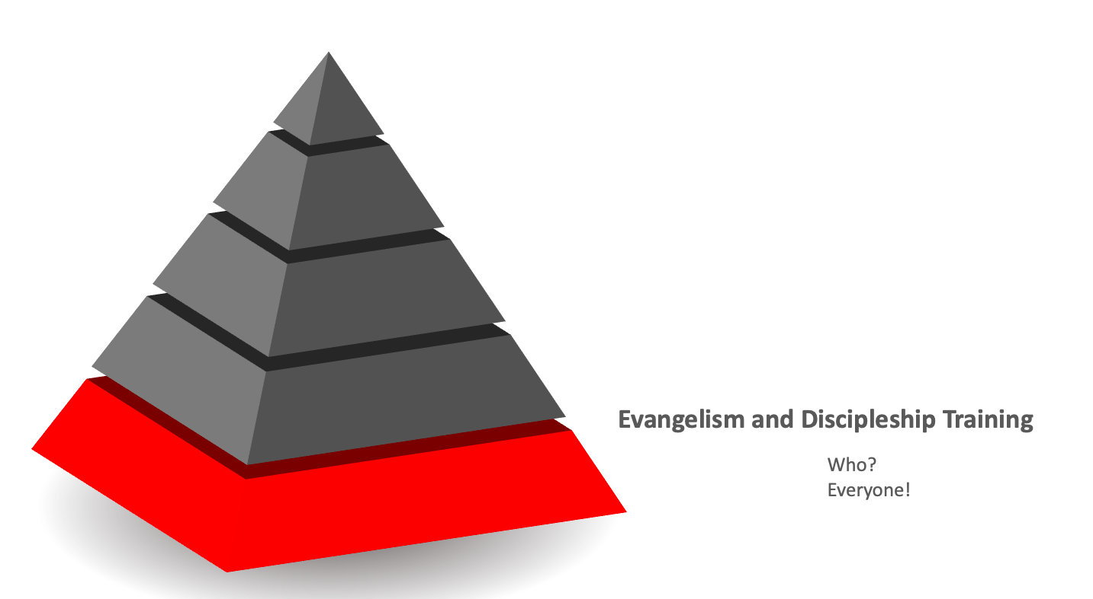

Slide 12
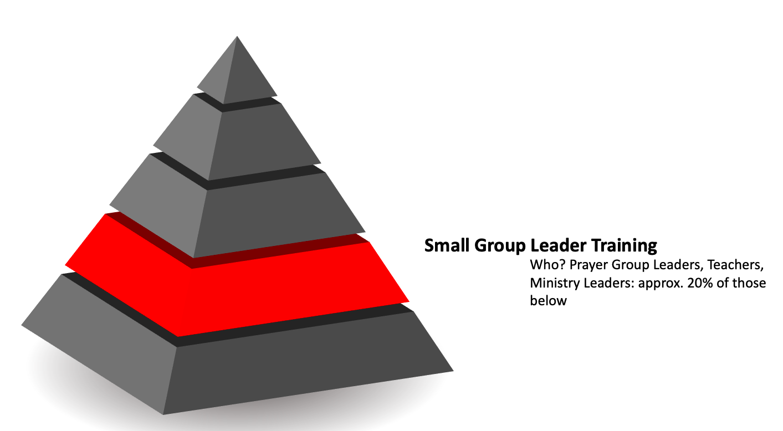

Slide 13
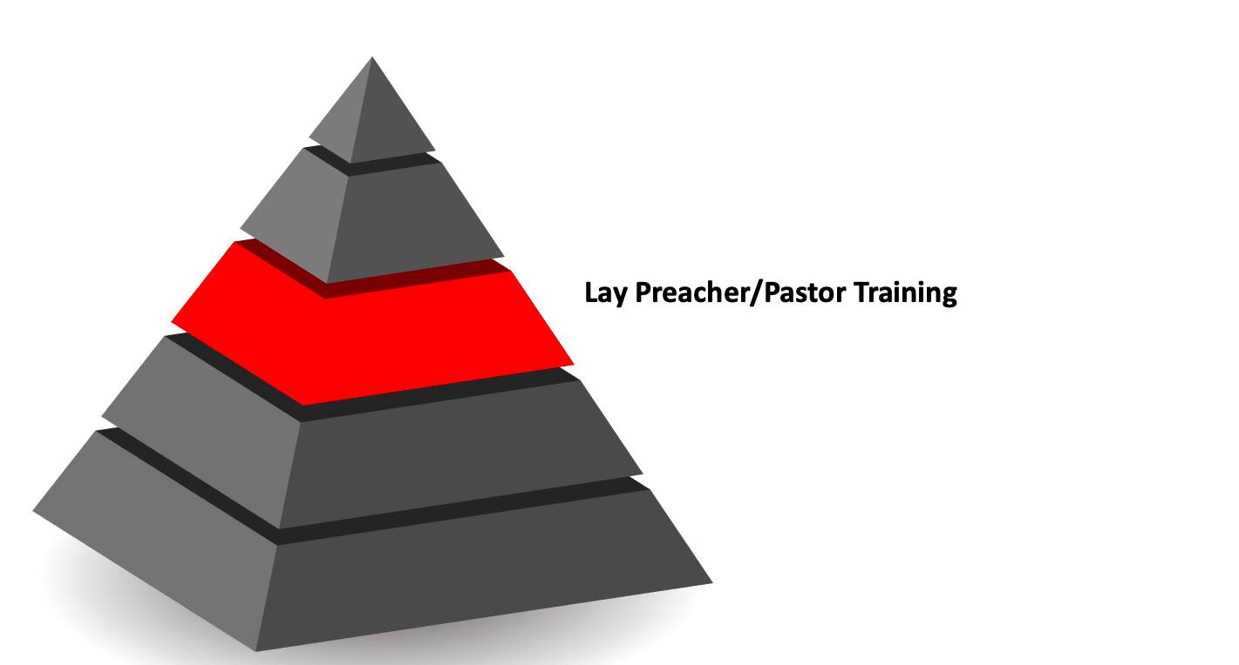

Slide 14
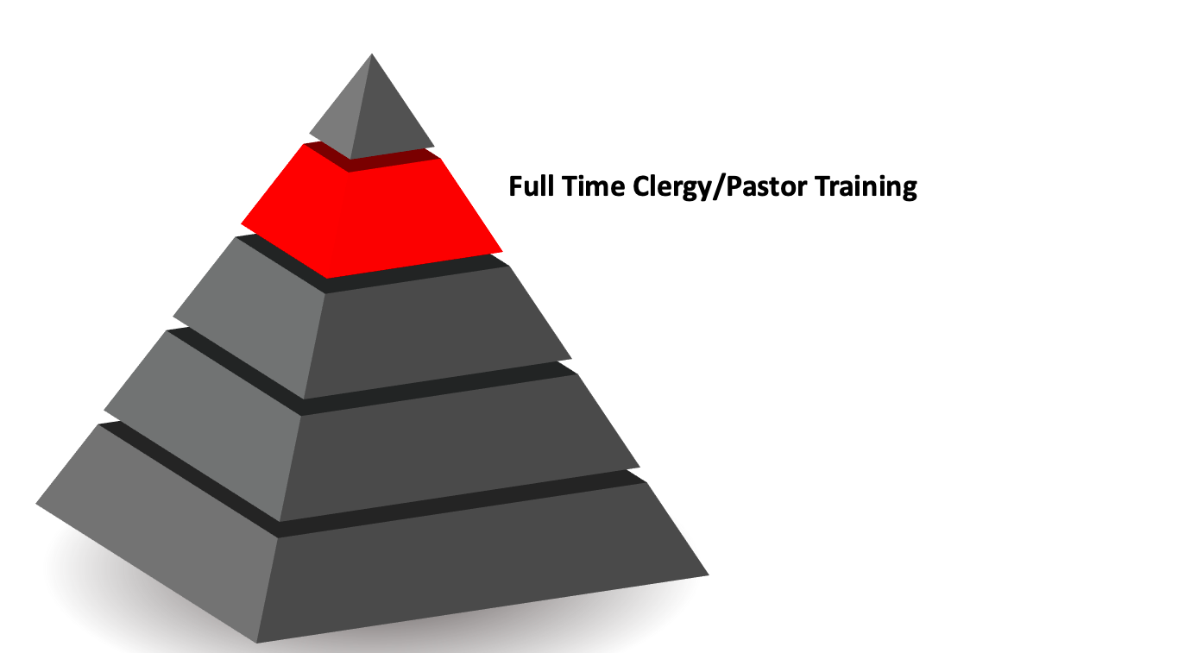

Slide 15
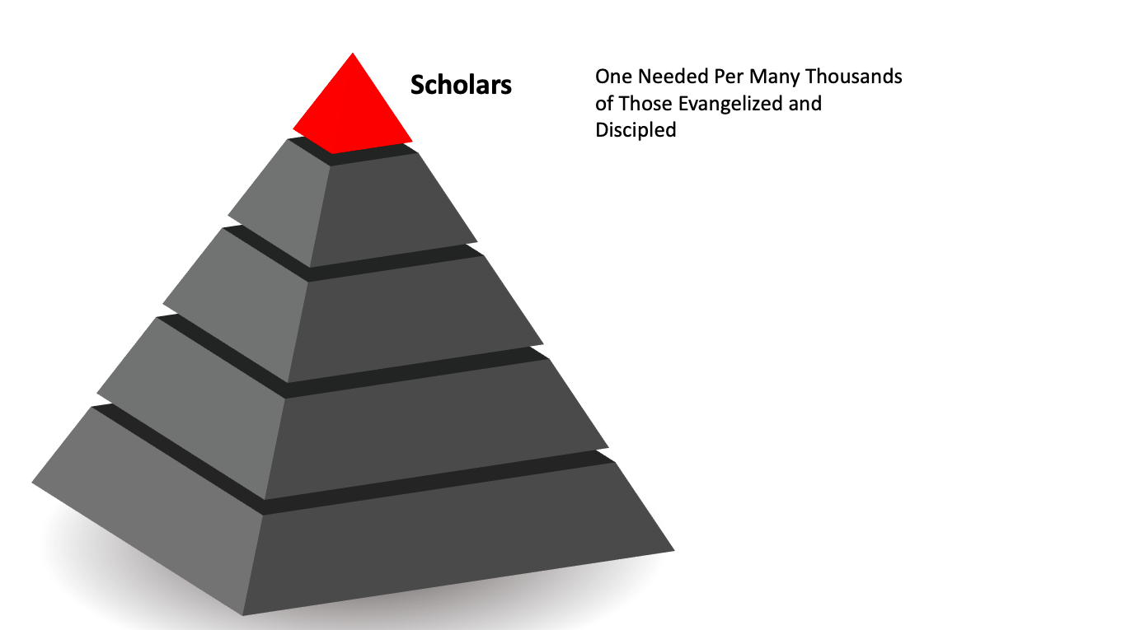

Slide 16
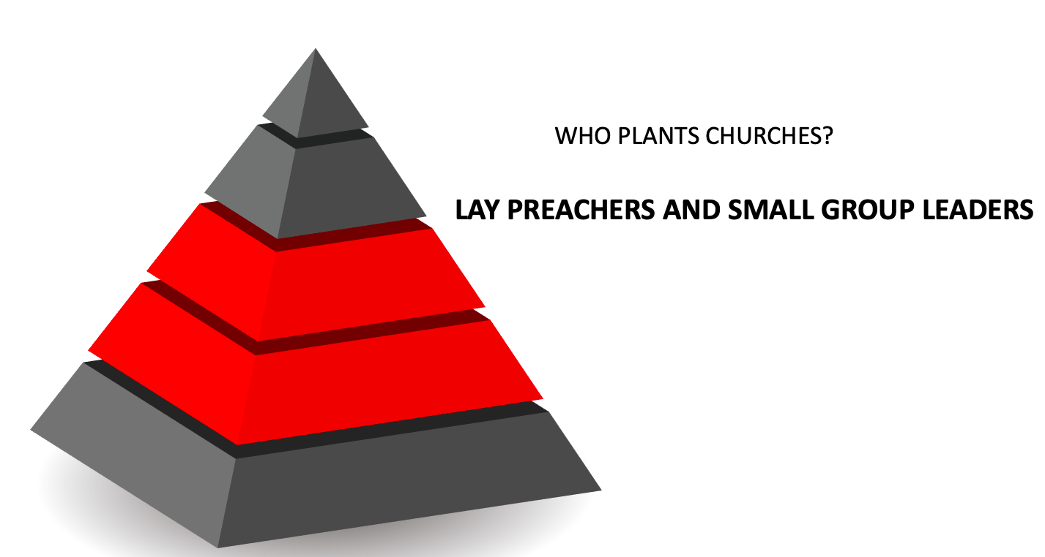

Slide 17


Slide 18


Slide 19


Slide 20
7. Global South and Expatriate Language churches (i.e. Filipino and others) are going to play a critical role going forward.
For example there are 150 “workers” in KSA…and 15,000 or more Filipino Christians. When ALL expat Christians are mobilized to reaching locals, we will increase our work force 1000 fold.
There is a “ worker trinity” of the missionary, the mobilized expat, and the MBB. When all three are working together at full strength….it will be remarkable.

Slide 21
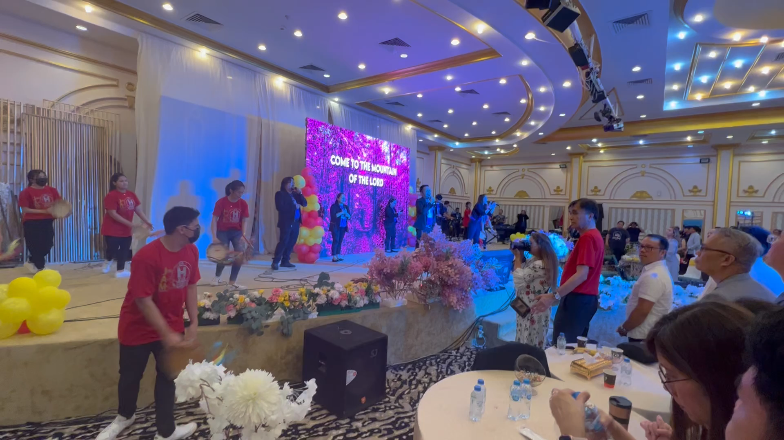

Slide 22
8. The Local, MBB, church must be envisioned and trained to be Missionary from the start
We cannot wait to inject missions theology and impetus until the church is strong or large. It must be the DNA of origin.
Missions is not Evangelism (Tanzania)

Slide 23
9. Denominations will form… and it is a good thing!
Media accelerates interaction and association
(Joel Olstein, Joyce Meyers…)
London Missionary Society – LMS
1795 – Non Denominational
Church Missionary Society – CMS
1799 – Anglican
Non-Denominational Agencies and Denominations
SUM – SCOC…..AIM – AIC

Slide 24
10. Harvest Time
CELEBRATION: We have never seen this many Muslims coming to Jesus
CHALLENGE: We are not staying up with Birthrates

Slide 25
CPM
4 Streams
4 Generations
Totaling 1,000 believers

Slide 26

1st Gen.
2nd Gen.
3rd Gen.
4th Gen.
Totaling at least 1,000

Slide 27
Jenn
Noor

Slide 28
Noor
Brother
Sister
Sister
Daughters

Slide 29
Noor
Brother
Sister
Sister
Daughters
Wife
Colleagues

Slide 30
Noor
Brother
Sister
Sister
Daughters
Wife
Colleagues
Family Members

Slide 31
Noor
Family Members
TAIF -
Media
Chat Room
(7000)
Family Members
JEDDAH
25
Colleagues
5

Slide 32
Noor
Family Members
JEDDAH
TAIF
25
Colleagues
5

Slide 33
Noor
Family Members
JEDDAH
Media
TAIF
25
3
Colleagues
5

Slide 34
Noor
Family Members
JEDDAH
Media
TAIF
Bedu Friends outside
MEDINA
25
3
Colleagues
5

Slide 35
Noor
Family Members
JEDDAH
Media
TAIF
MEDINA
25
3
Colleagues
5

Slide 36
Noor
Family Members
JEDDAH
Media
TAIF
MEDINA
25
3
Colleagues
5

Slide 37
Noor
Family Members
JEDDAH
Media
TAIF
MEDINA
24
25
3
Colleagues
5

Slide 38
Noor
Jeddah
Taif
Medina
Brother
Sisters
Daughters
Media
Bedu
Family Members
Wife
Colleagues
56

Slide 39
56 + 6 + 20
Believers
House
Church
Noor

Slide 40
4 Streams
Started through a Media Contact
Started through Affinity Connections
Started by “Broad Sowing”
Started by Aggregate Collection
ALL streams had multiple occurrences of dreams, miracles, signs, and wonders

